Slide 1


Operational Excellence
One standard way of working for Air and LCL Business

Slide 2
Why We Need a Standard Way of Working
Current Issues (As-Is):
1. Multiple sources of information (no single source of truth):
Area Pulse Monitor mostly used by FINOPS/BCOs – Source SAP
Page 1 LCL & Air - Power BI used by OPS – Data from CW1/SAP/ALP and TMFF
Air LCL cognitive hub - Power BI used for CW1 Adoption deep dive – Milestones dashboard
File Healer app ALP pushing adoption for Operators and Team leaders
CargoWise One – Used by operators (resistance to be used by Team Leaders) – usually perceived as not user friendly
Local Tools – Usually excel reports a mix of SAP/CW1
2. Data gaps in File Healer app → unreliable reporting
Each country has different and multiple exceptions making it difficult to mirror the count of sick files from CW1 i.e.. SCM Billing exceptions / periodic billing, etc
3. CW1 not fully used → inconsistent processes:
Team leaders not using filtering options (Operators not 100% adoption)
FINOPS/BCOs not using reporting capabilities of CW1 (or Page 1)
Desired State
* * **
CW1 File Healer Page 1
Operators
Team leaders / SU
Station Managers
FINOPS
BCO
High Level Stakeholders
* Leading KPIs
** Lagging KPIs

Slide 3


Leading Indicators (Proactive)
Predict future performance and drive proactive action. Example: Daily booking completion rate.
Lagging Indicators (Retrospective)
Measure past performance and results. Example: Monthly invoice accuracy rate.
Type of Sick File | Type of Sickness | CW1 | File Healer App
Operational | Missing Export Milestones | Yes | Data gap
Operational | Missing Import Milestones | Yes | Data gap
Financial | Empty Jobs | Yes | Yes*
Financial | Missing Rev | Yes | Yes*
Financial | Missing Cost | Yes | Yes*
Financial | Vendor Dispute | Yes | Yes*
Financial | Unbilled Revenue | Yes | Yes*
Financial | Pending ICB | Yes | Yes*
Financial | Pending Soft Closure >7 days | Yes | Yes*
Financial | Pending Hard Closure >75 days | Yes | Yes*
Financial | Open Cost >60 days | Yes | Yes*
Summary | Overall Operational Sick Files | No
Summary | Overall Financial Sick Files | No
Metric | Focus Area | Page 1 - Y/N
CW1 Adoption | Productivity
Auto-rating Sell | Productivity
Invoice Accuracy | Customer Outcome
Invoice Timeliness | Customer Outcome
PO Creation timeliness | Vendor Outcome
First Time Hit Ratio (FTHR) | Vendor Outcome
Vendor Payment on Time | Vendor Outcome
Non-Soft Close | Financial controls
Non-Hard Close | Financial controls
Milestone Timeliness | Operational Performance
Milestones Completeness | Operational Performance
*Enabling customized filtering is essential to avoid the development of multiple logic layers

Slide 4
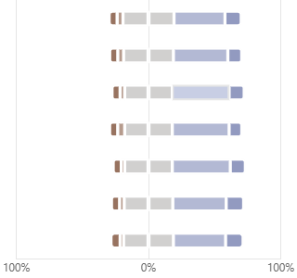
The voice of our Customer
Do you understand the logic and concept of Sick Files?
How confident are you in identifying the type of sickness overall
How often do you use Sick Files in CW1 when managing shipments?
How often do you use the File Healer App to review Sick Files?
Since the introduction of Sick Files, has visibility of pending milestones improved?
Missing WIPS
Missing Revenue
Missing Accruals
Missing Cost
Empty Shipments
Non-Soft Close
Non-Hard Close
51%
53%
55%
52%
56%
54%
52%
Where do you "fix" the Sick Files?
The CW1 Sick Files filter in CW1 provide me with clear visibility on Invoicing backlogs
How satisfied are you with the Sick Files tools for identifying and addressing backlogs in your workflow?
The CW1 Sick Files filters in FH help me easily identify the following issues
We discuss Sick Files during our MOS or team huddles
Clearer guidelines & explanations → Requests for defined rules, purposes, and simpler instructions.
More training / refreshers → Both initial and ongoing sessions (including quick tips or refresh training).
Better usability → Improved filters, export options, lighter colour schemes, and faster system response.
Regular updates & visibility → Want timely updates, automated reporting, and consistency across regions.
Forgetting / Lack of habit → Several people mentioned they “sometimes forget” or don’t check daily.
Lack of clarity or training → Respondents aren’t always clear on the purpose/benefits, rules, or how to use them effectively.
System/usability issues → Concerns with filters, colors, slow performance, or missing features.
Not relevant to their scope → Some believe it’s outside their role or not needed for their tasks.
Roles
Product
Region
Operations Staff | 59%
Team Leader | 17%
Manager | 13%
GSC | 9%
Finops | 2%
SME | 1%
AIR | 56%
LCL | 44%
APA | 39%
NAM | 36%
EUR | 17%
IMEA | 9%
140 replies
What change or improvement would help you and your team adopt Sick Files more effectively?
What prevents you from using Sick Files filters in CW1 and File Healer App more consistently?

Slide 5
Call to ACTION – Driving Value Together
What We Are Doing Today (Value-Adding Initiatives)
Workflow Implementation → Enhancing efficiency and consistency in execution.
Milestone Clean-Up Initiative → Reducing complexity (from 257 to ~20 milestones) for clarity and better reporting/user experience.
Tailor-Made CW1 Filters → Training team working area by area to design custom filters that enable effective huddles, quick identification, and correction of sick files.
Enhanced File Healer App → Improving visibility for management to track sick files, driving adoption, accountability, and stronger performance.
Super User Engagement → Building ownership and driving adoption across regions.
Where We Need Alignment & Support
Clear Global Standards
→ Commit to ONE standard way of working / Decision needed on preferred reporting tool to be used and enhanced (Clear source of info)
→ Agreement on the right tool for your role (We all give the same message in Center)
System Adoption Accountability
→ Ensuring operators use CW1 fully, managers leverage dashboards, and leaders drive adoption
Sustainability & Change Management → Ongoing reinforcement, communication, and sponsorship from leadership to embed practices with the support of BCM/BPE/OPEX Teams

Slide 6
Thank you! For support on how to embed this way of working into your daily operations, please reach out to the Business Change Air & LCL team: +D TbM GPL BCM Air & LCL <TbMGPLBCMAir&LCL@maersk.onmicrosoft.com>

Slide 7
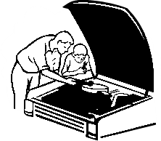





OPEX is built on 5 pillars for a sustainable lean performance that must work together to be successful
Our Lean Management approach addresses 5 areas starting with customer
How To Drive?
All 5 components of the OPEX Car must work together for the car to drive.
If the engine does not work – the car wont start
If we do not have a steering wheel – we cannot control the car
If the driver does not know how to operate – we might crash
If we do not have any fuel - we will not go anywhere
Without the GPS - we do not know where we are going
Combining these five elements will enable us to drive the road to success
Process Effectiveness and Efficiency
Performance Management
Performance Management act like a steering wheel for the management. This enables them to drive the right processes
Process Effectiveness & Efficiency is the engine of successful lean operations. This secures that processes are carried out in the optimal way
GPS
Mindsets & Behaviours
Organization & Skills
Mindsets & Behaviour is the driver of the lean methodology. Without the right mindsets and behaviour, lean operations will go nowhere
Organization & Skills is the fuel that ensures that the lean operations keep running continuously.
SOURCE: Opex Navigator Team

Slide 8
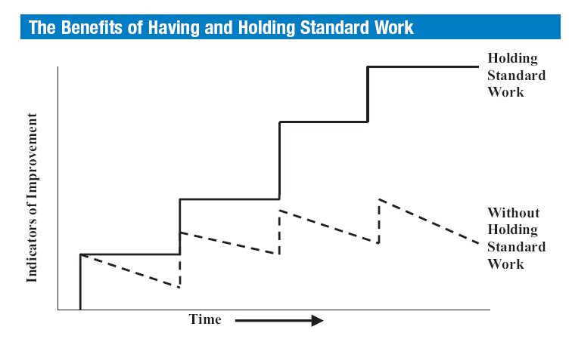
The importance of Standard Work
Making the “new way” become the standard way
SOURCE: Damco OPEX Team
8
Notes:
Saw tooth line:
After a process improvement we can often observe that without standard work, the improved performance falls away over time, resulting in further process improvement work being required to get performance back to the initial level.
Stair case line:
However if the standard work is embedded it gives a platform for further continuous improvement to take performance to a new higher level.

